Slide 1
The Ideal Neighborhood for New Restaurants in Toronto
Coursera capstone project
Adam Gary

Slide 2
Location is paramount when opening a new business
Prospective new store owners need to take into account many different factors when deciding where to open their business, even moreso for a business such as a restaurant.
Knowing the location and neighborhood density of different genres of food would help owners know better neighborhoods to target, since opening the 2nd Italian restaurant in a neighborhood likely has better staying potential and earning potential than the 8th Italian restaurant in a separate part of Toronto.
There are additional factors a prospective restaurant owner might utilize, such as data within their specific cuisine about the targeted audience and price range for restaurants in the area.
Additionally the quality of the existing restaurants in the area may provide information about potential in opening another restaurant of the same cuisine in a given neighborhood.

Slide 3
Data acquisition and cleaning
Initial data acquisition was creating a data set of Toronto neighborhoods, boroughs, and zip codes for mapping and clustering purposes.
Some data cleaning was done to remove unnecessary columns and blank rows. Afterwards we connected those boroughs to latitude and longitude coordinates in order to place and cluster them on a Folium map.
Next, I used FourSquare to extract all the coffeeshops near Toronto into a dataframe for further analysis. Then k-means clustering was used to cluster the boroughs into 5 different groups, in order to get an idea of neighborhood density in Toronto.
This was followed by getting a tally of the number of coffeeshops within each cluster, and then a graph was made to show the number of coffeeshops within each cluster of boroughs.

Slide 4
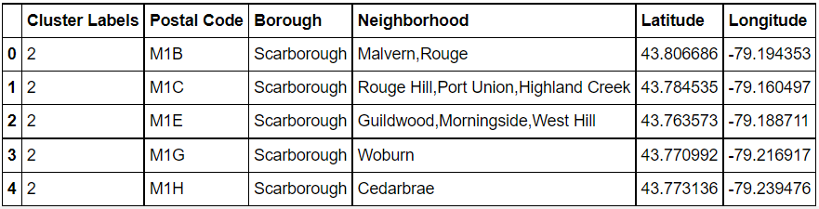
Gathering and clustering neighborhoods

Slide 5
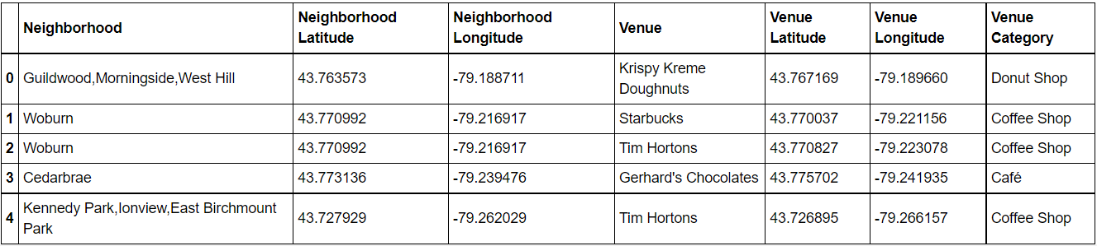
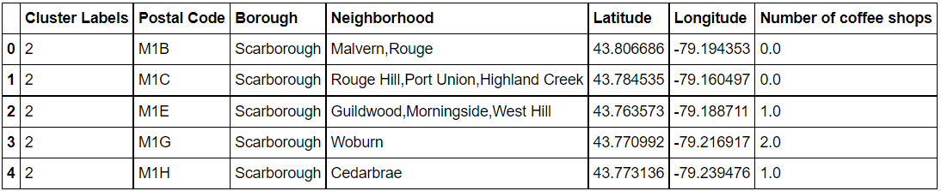
Counting coffee shops in neighborhoods, then tallying the number within each neighborhood

Slide 6
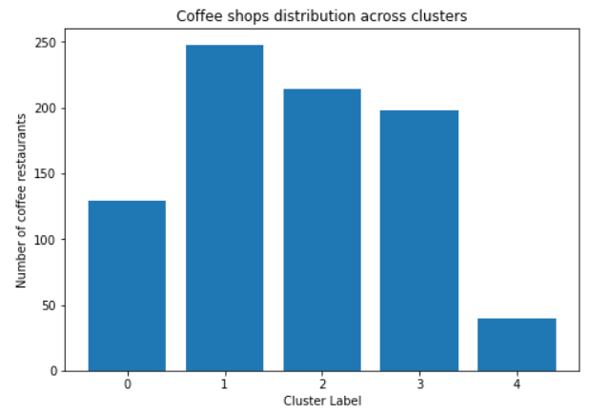
Plotting the number of coffee shops within each cluster
We can see that cluster 4 contains the least number of coffee shops in Toronto

Slide 7
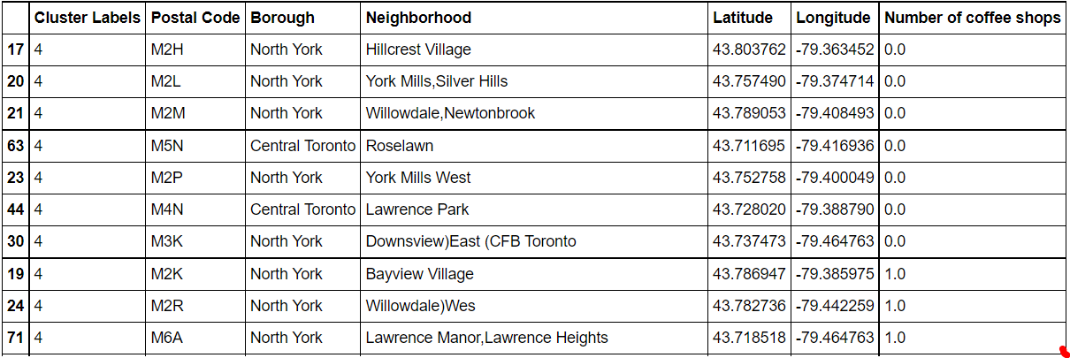
Ideal neighborhoods to open a new coffee shop
These neighborhoods have only one or zero coffee shops currently, so they would be most suited to opening a new coffee shop

Slide 8
Discussion
This analysis is not perfect, as it is based upon zip codes and borough density – this is probably correlated but not directly linked with population itself, as some zip codes may have a much lower population density.
This would skew our results, as a more populous zip code would be able to support a higher number of coffeeshops.
The number of coffeeshops within cluster 4 is such a stark difference from most of the other clusters, that I am relatively confident that opening a coffee shop within that area would still be able to succeed based on the lack of competition there.

Slide 9
Conclusion
An entrepreneur would be best served opening a coffee shop within the Cluster 4 area of neighborhoods, as that shop would face the least competition from other stores in the area.
They could then provide a service and product that is unavailable or less readily available to the population living there, who otherwise need to go to a different neighborhood to get what they are looking for.

